Slide 1

Elevation
Risk Management Chapter Education

Slide 2
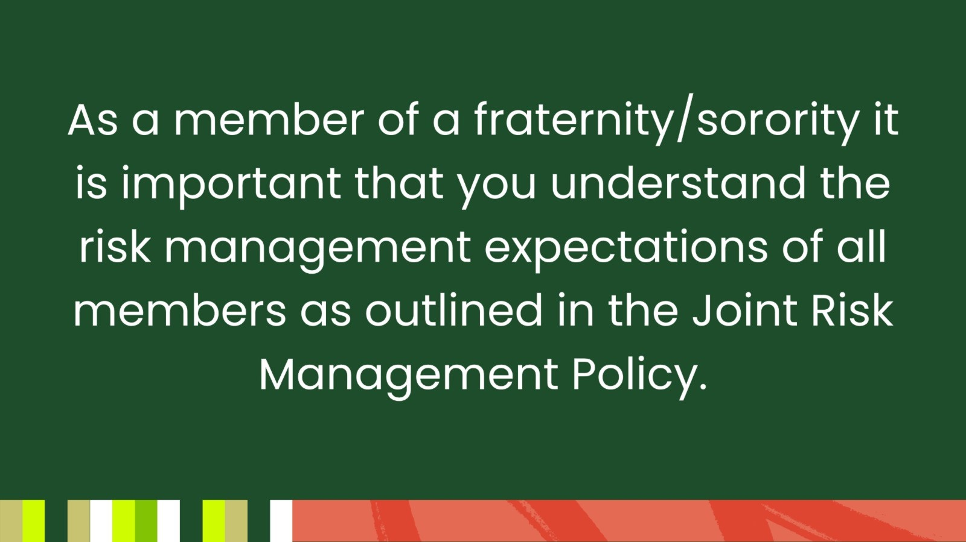

Slide 3

You might be thinking….

Slide 4
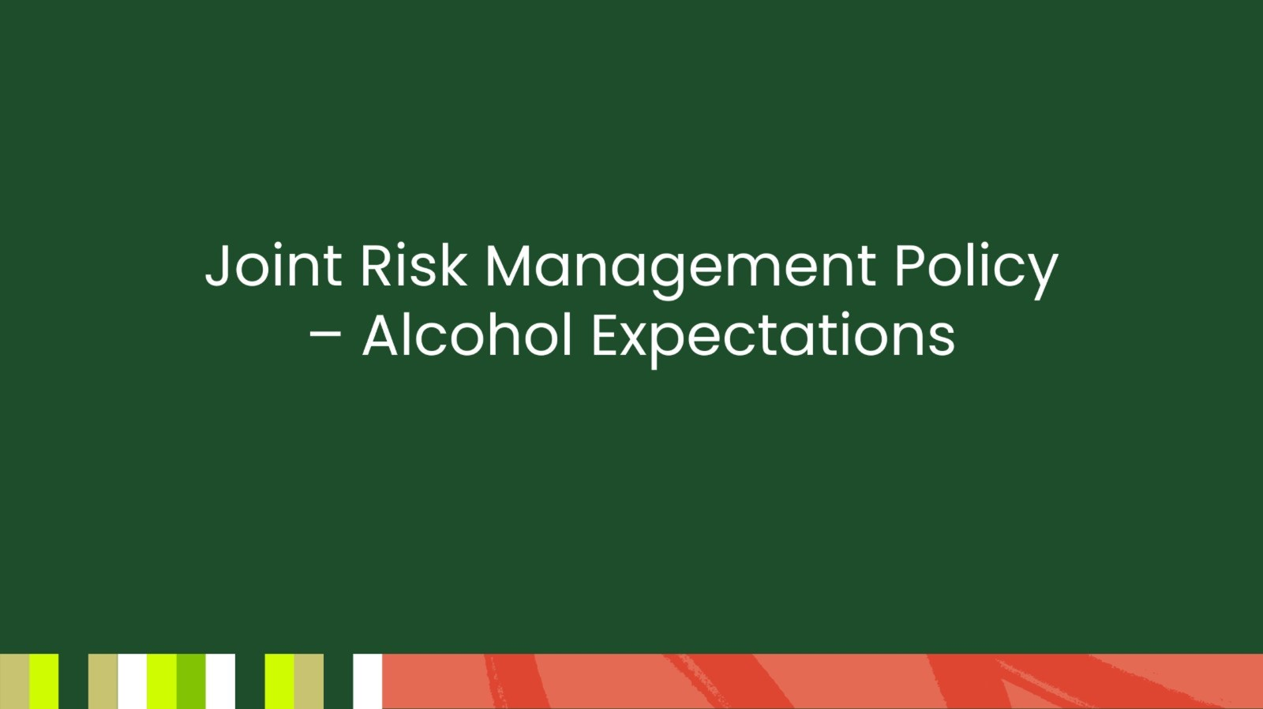
Joint Risk Management Policy – Alcohol Expectations

Slide 5
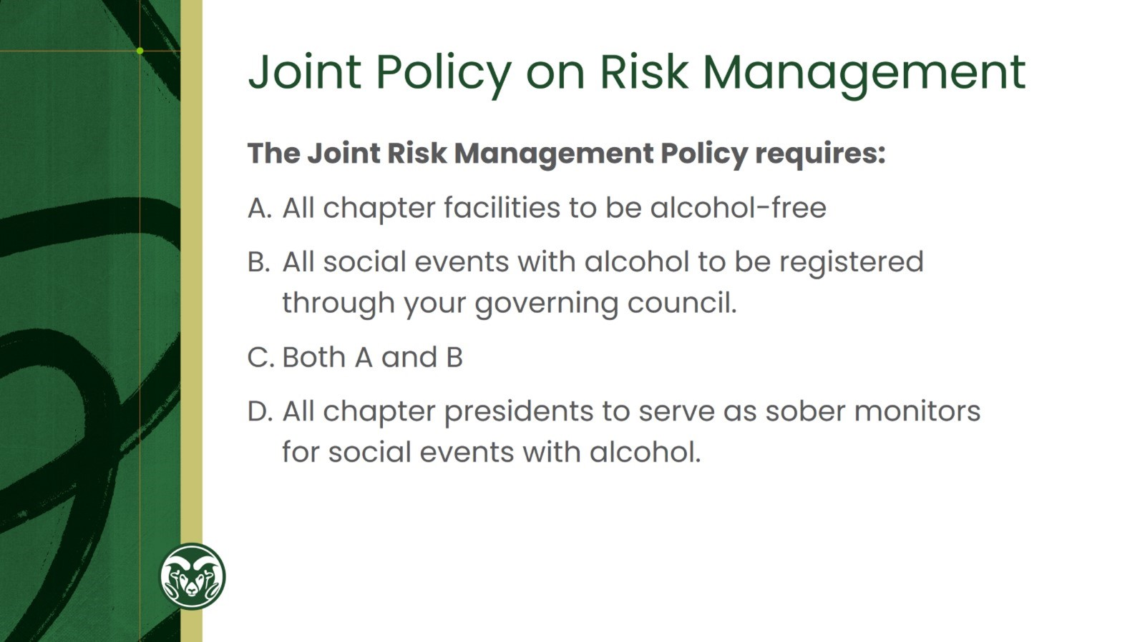
Joint Policy on Risk Management

Slide 6
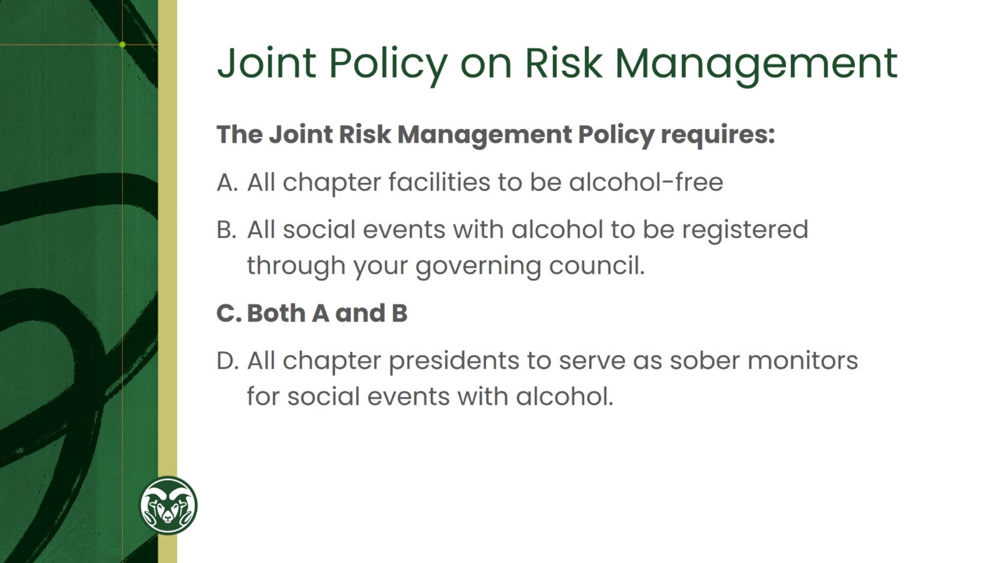
Joint Policy on Risk Management

Slide 7
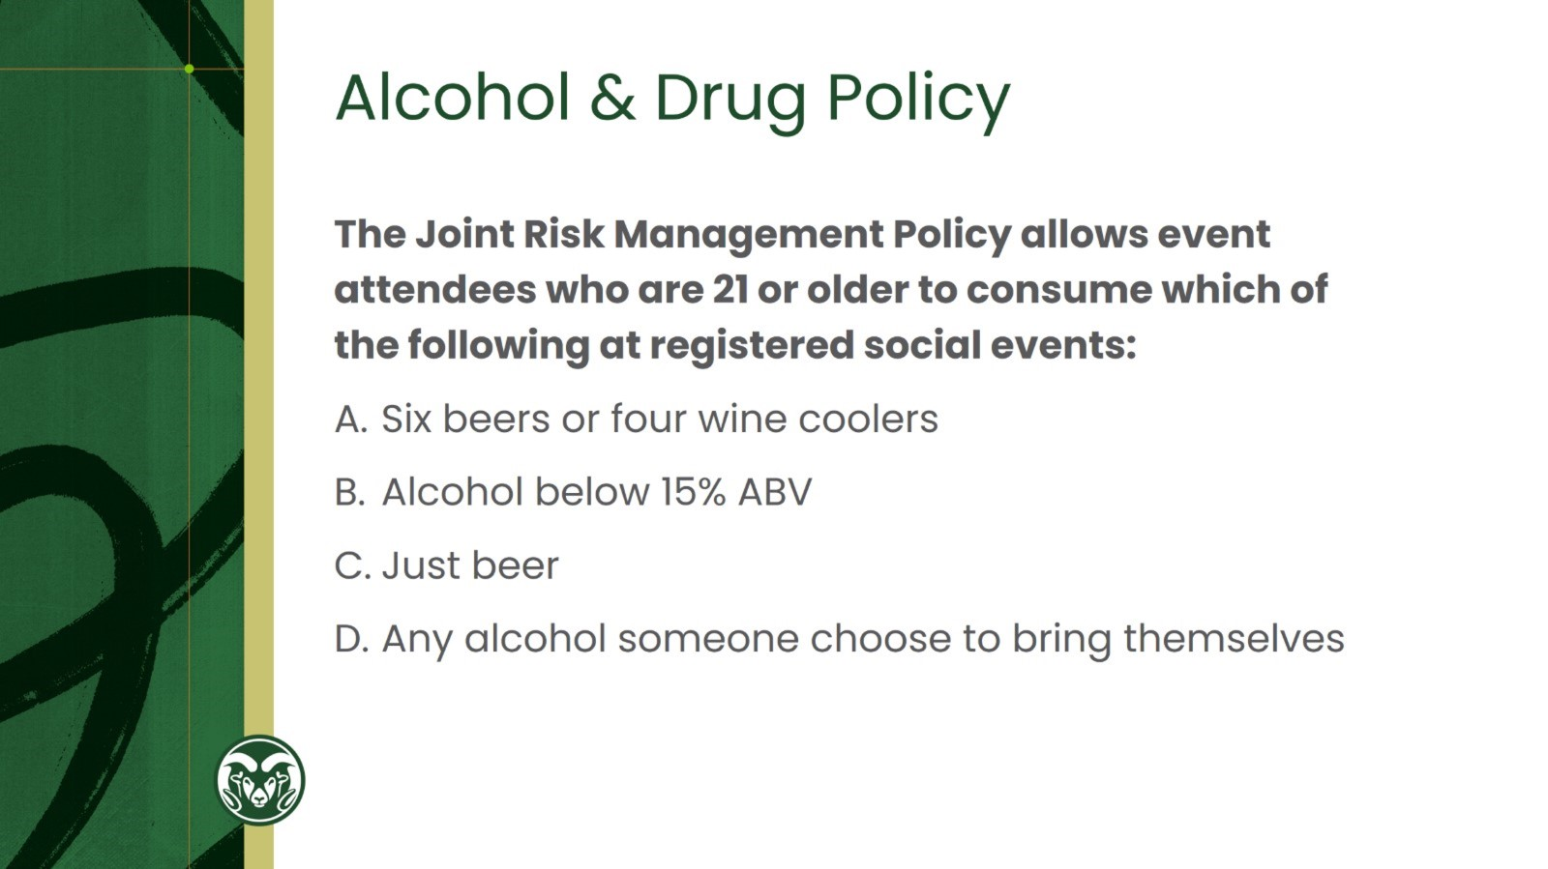
Alcohol & Drug Policy

Slide 8
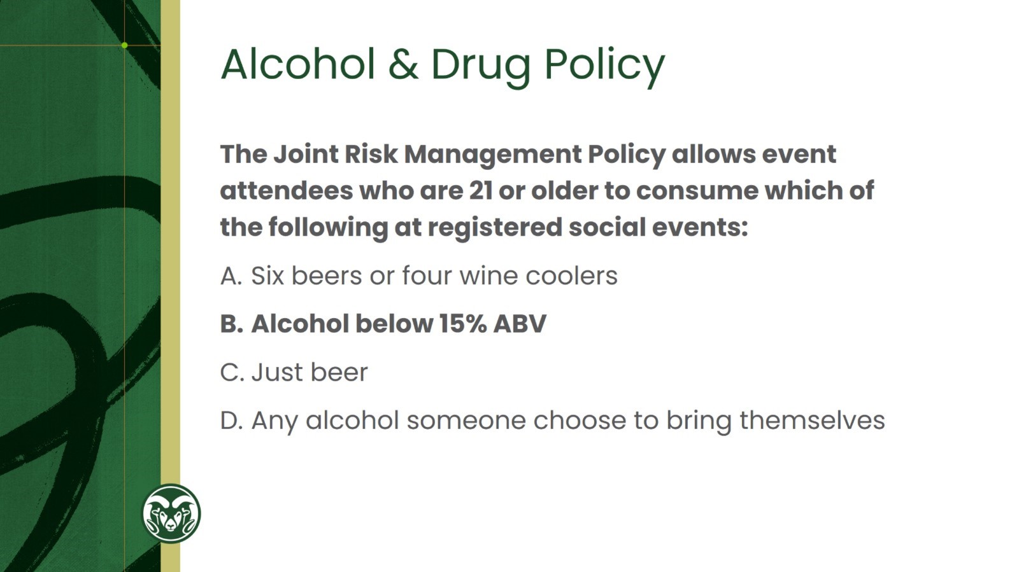
Alcohol & Drug Policy

Slide 9
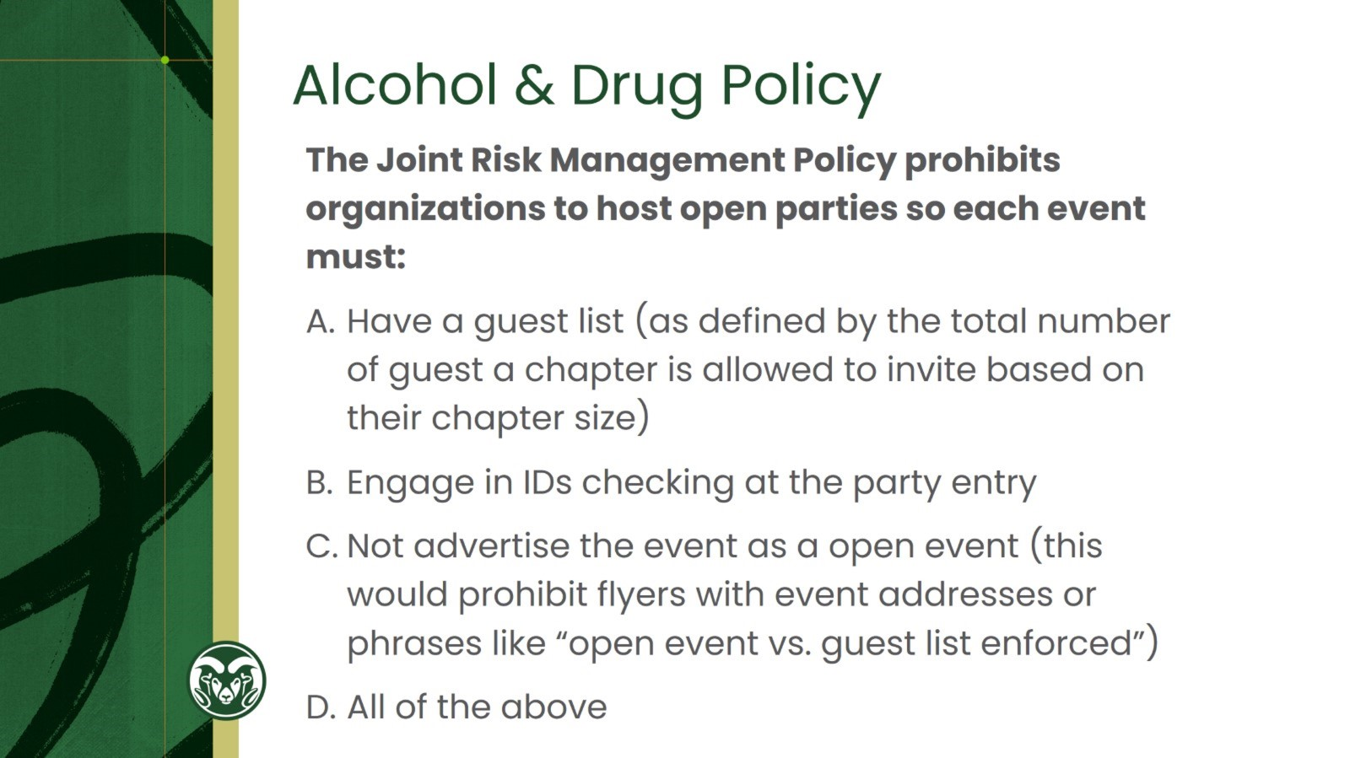
Alcohol & Drug Policy

Slide 10

Alcohol & Drug Policy

Slide 11
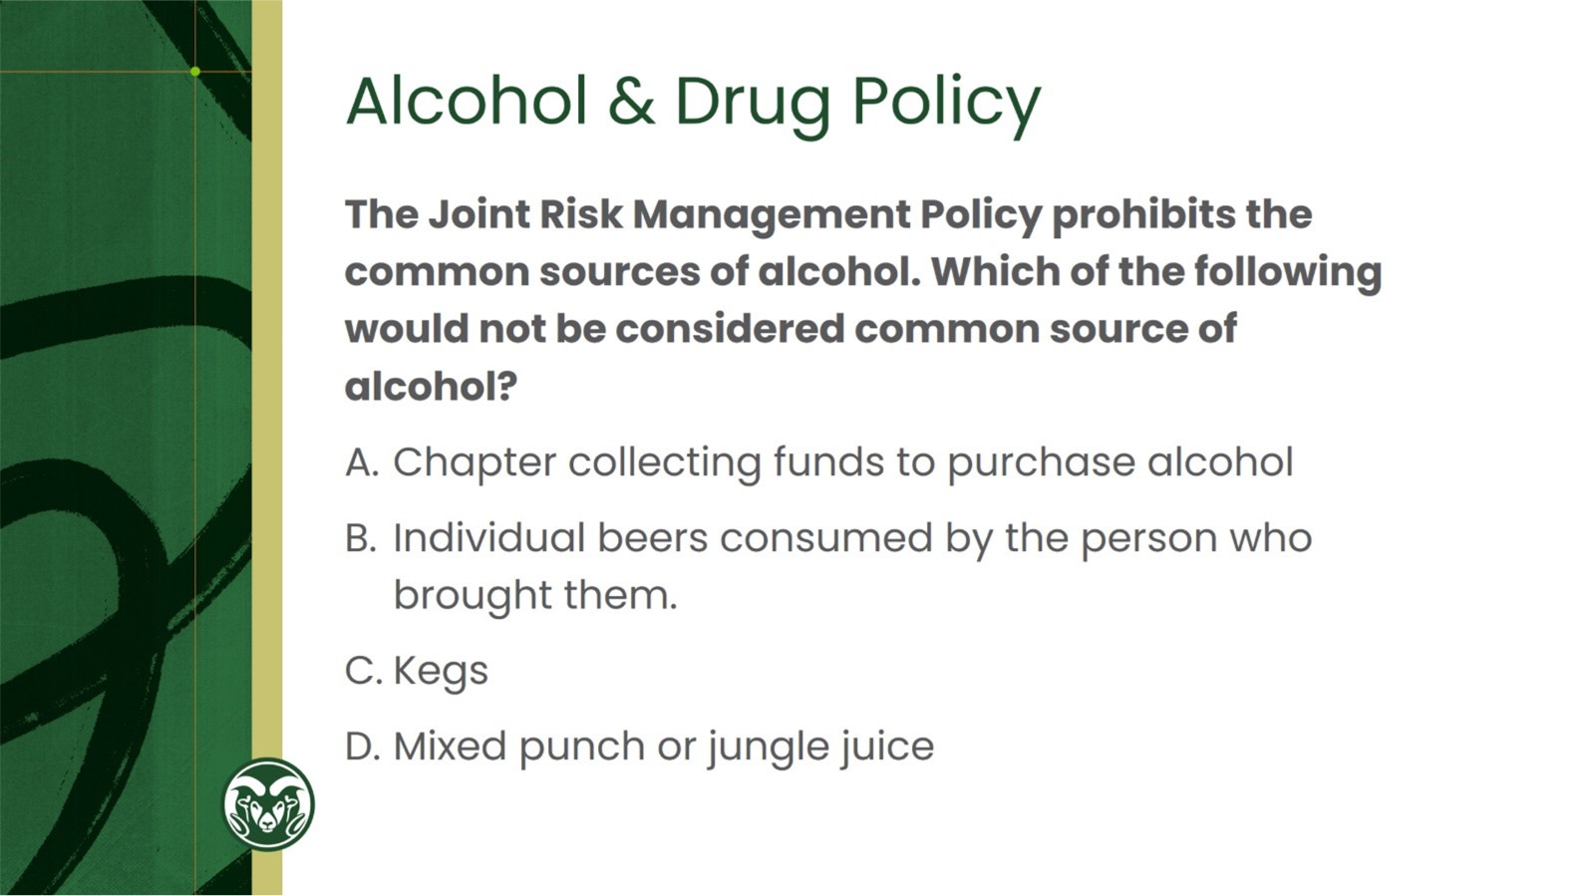

Slide 12
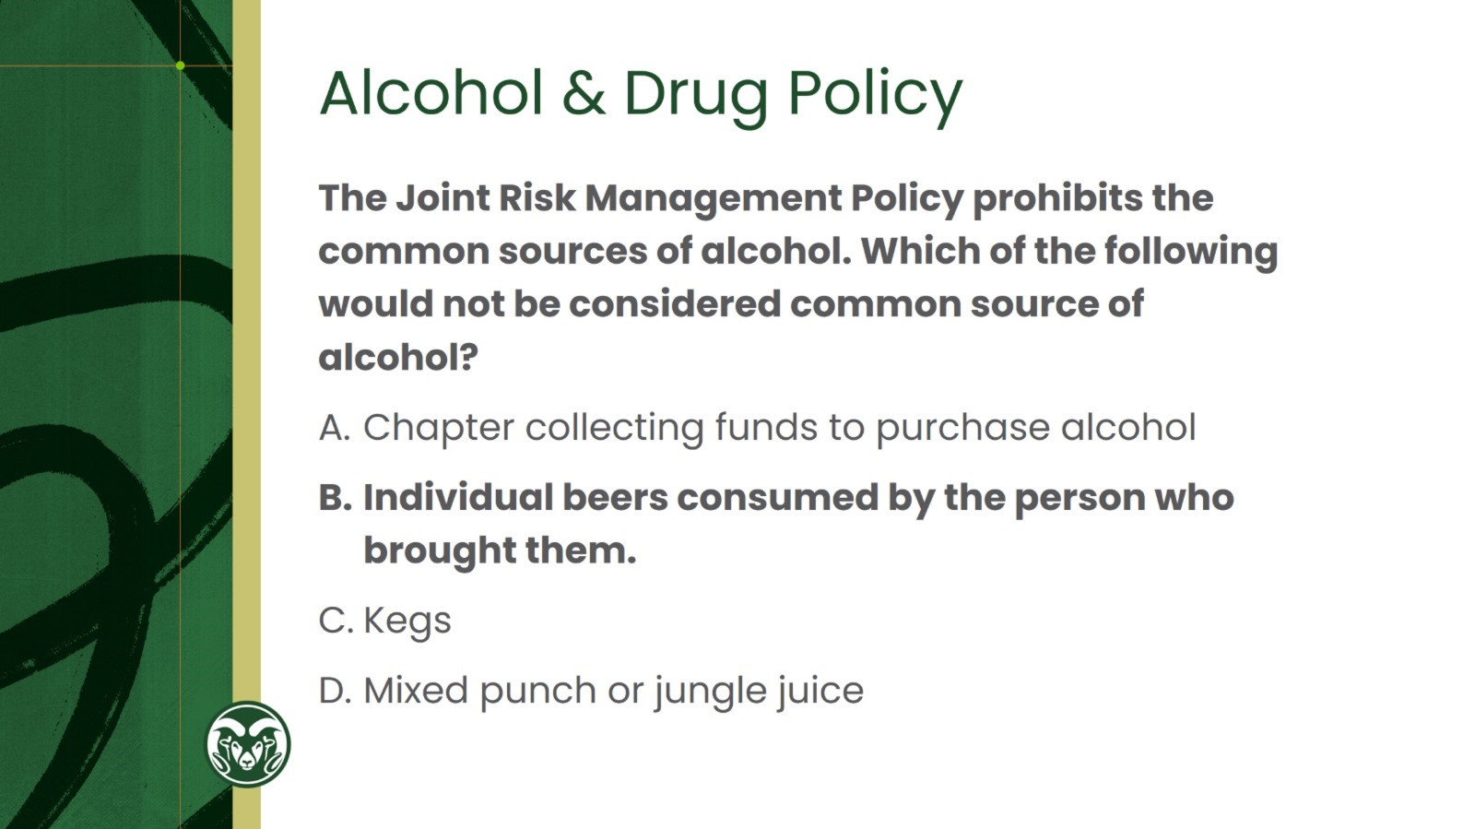
Alcohol & Drug Policy

Slide 13
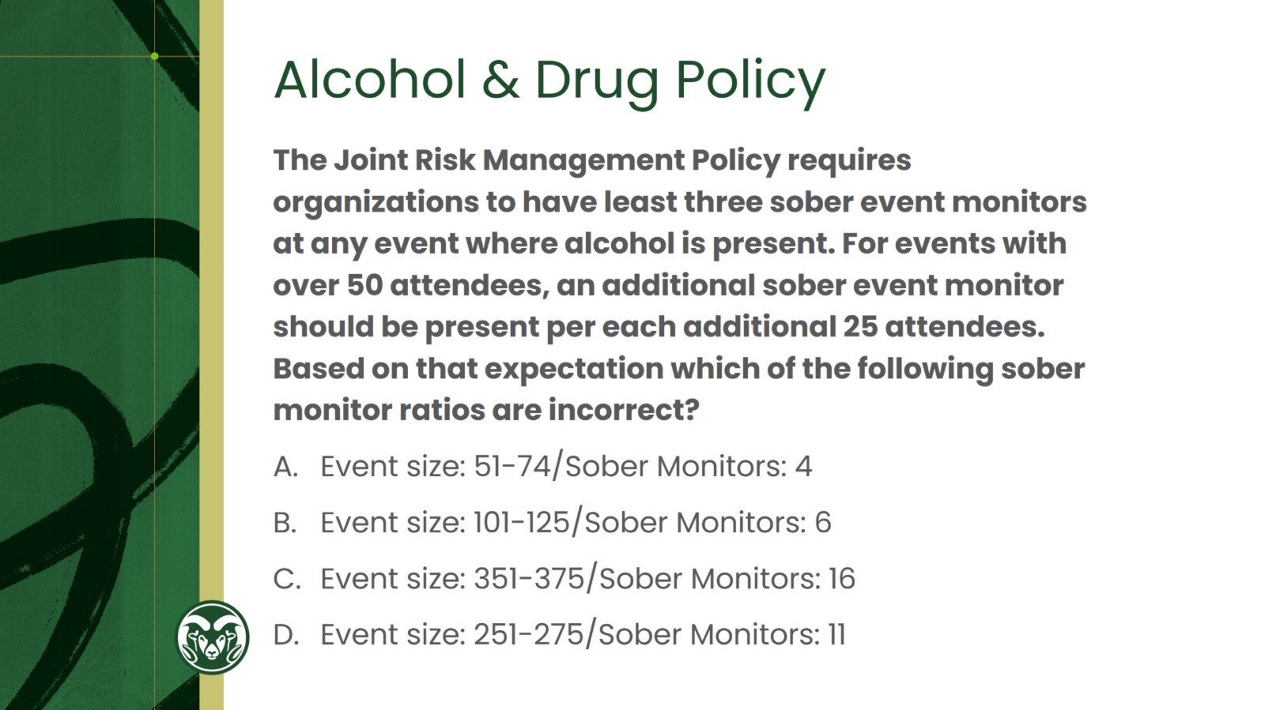
Alcohol & Drug Policy

Slide 14
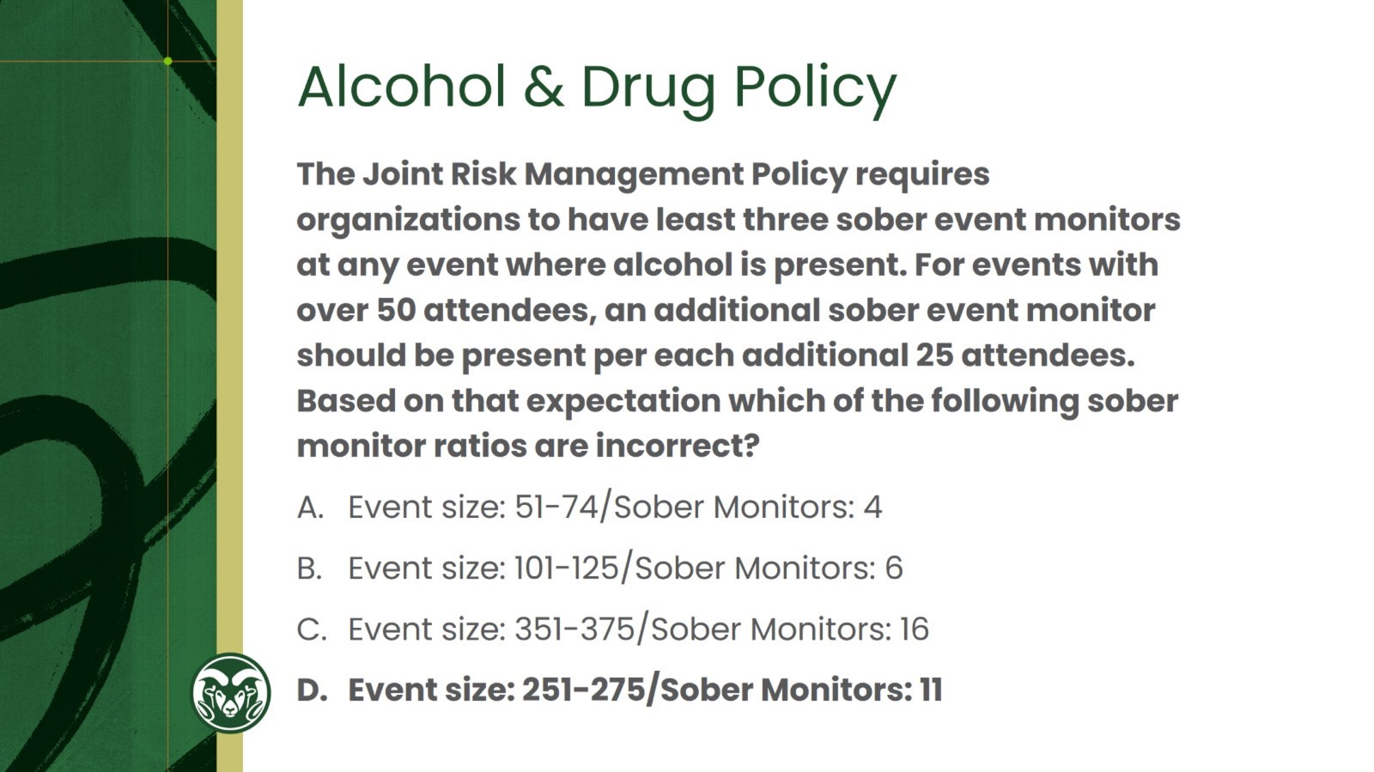
Alcohol & Drug Policy

Slide 15
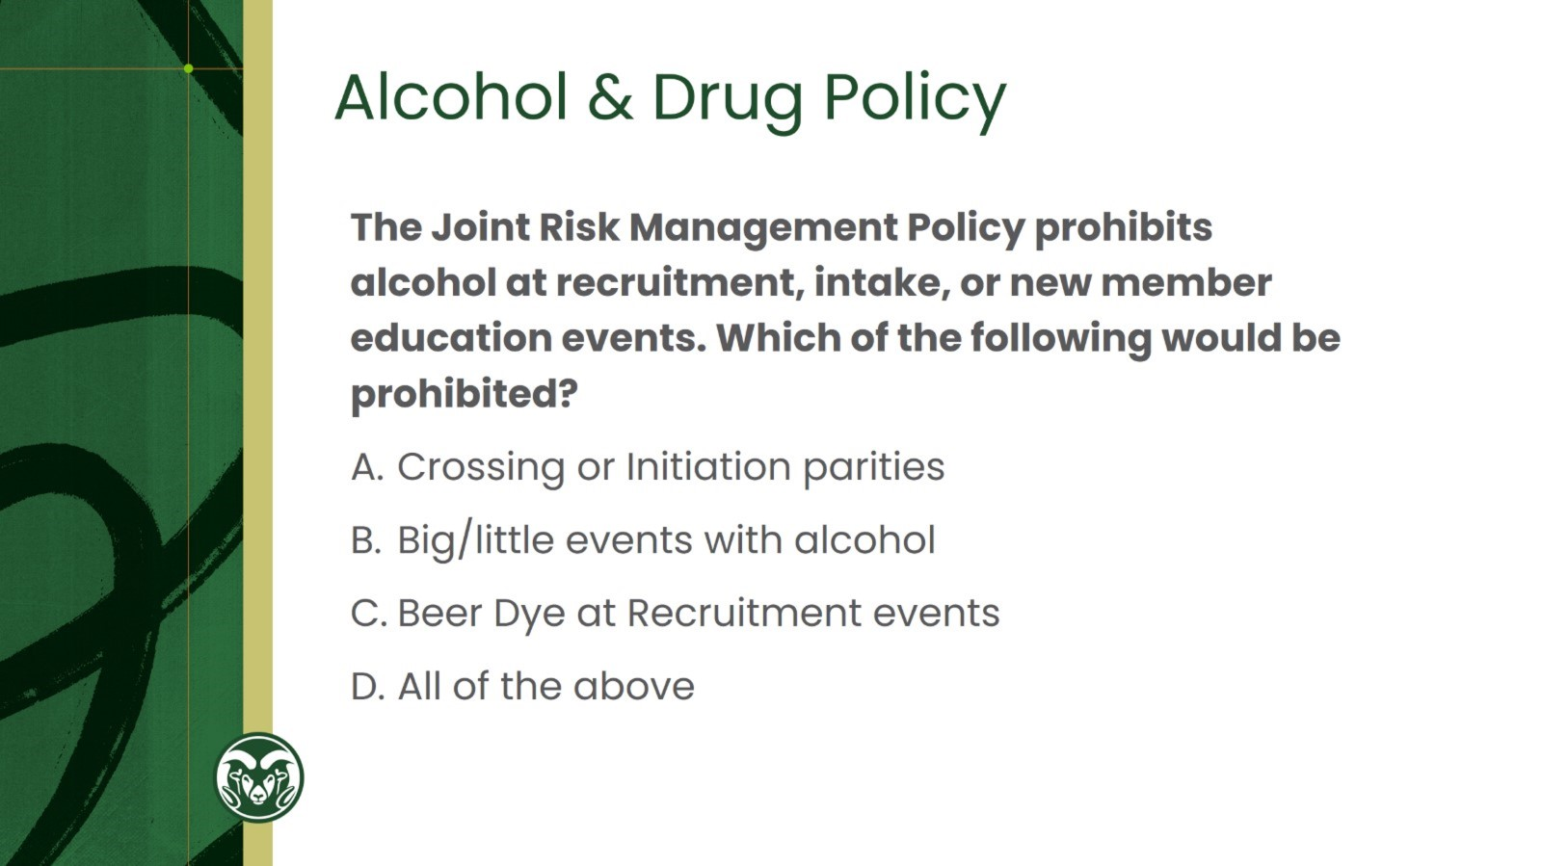
Alcohol & Drug Policy

Slide 16
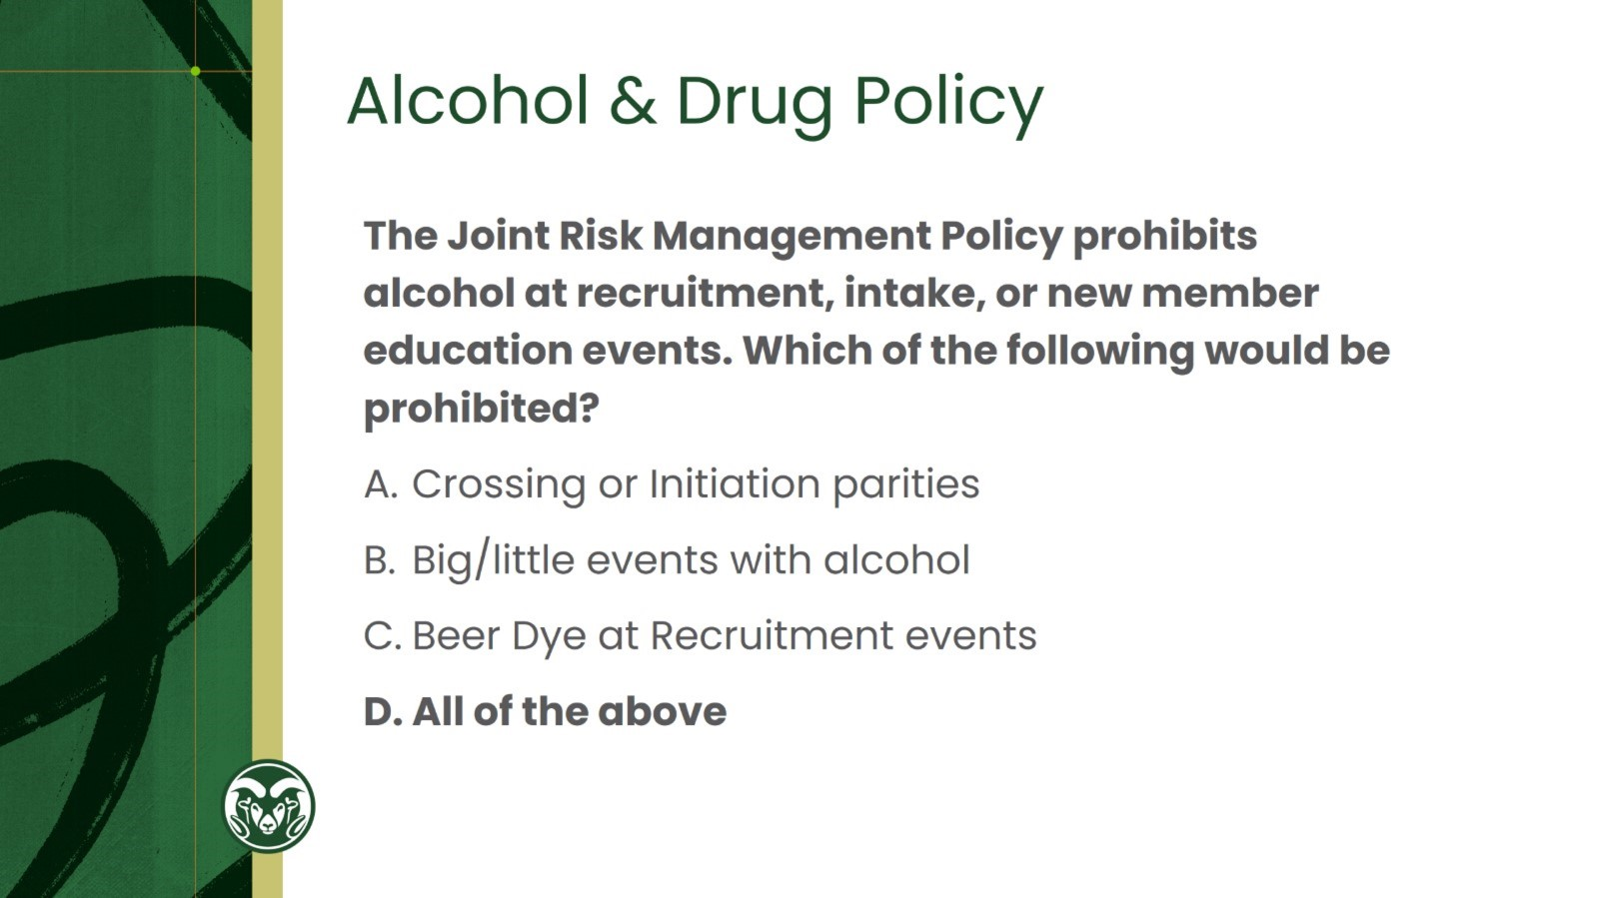
Alcohol & Drug Policy

Slide 17
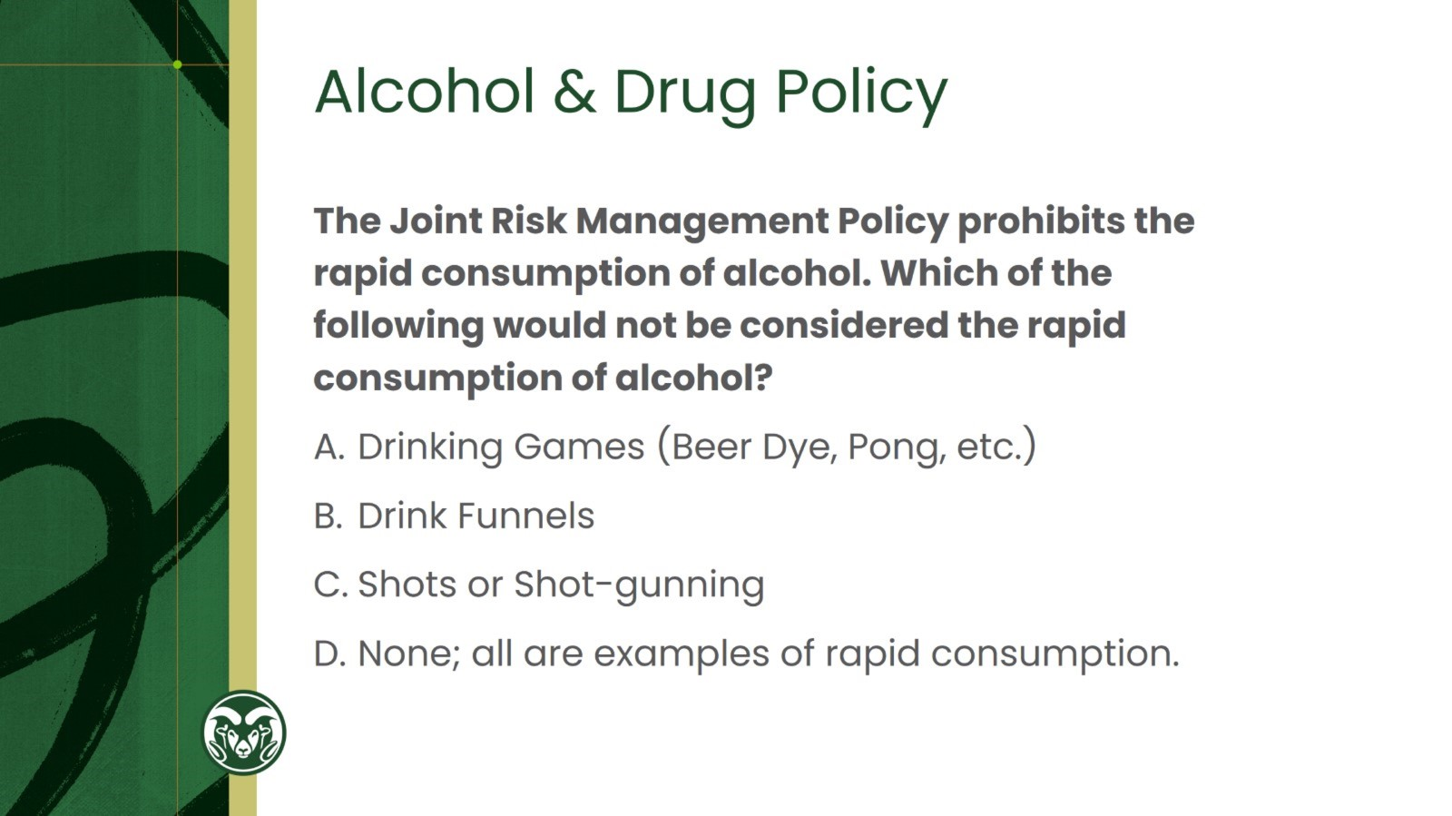
Alcohol & Drug Policy

Slide 18
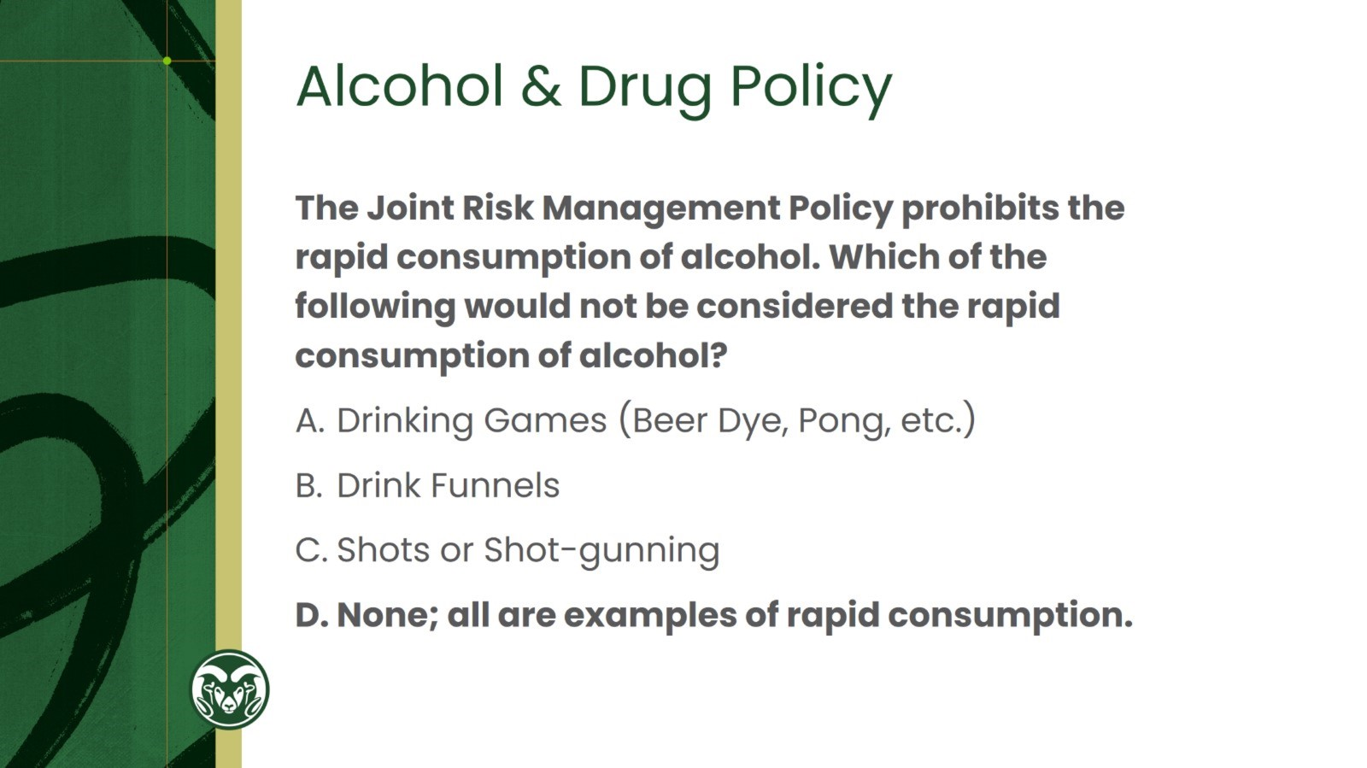
Alcohol & Drug Policy

Slide 19
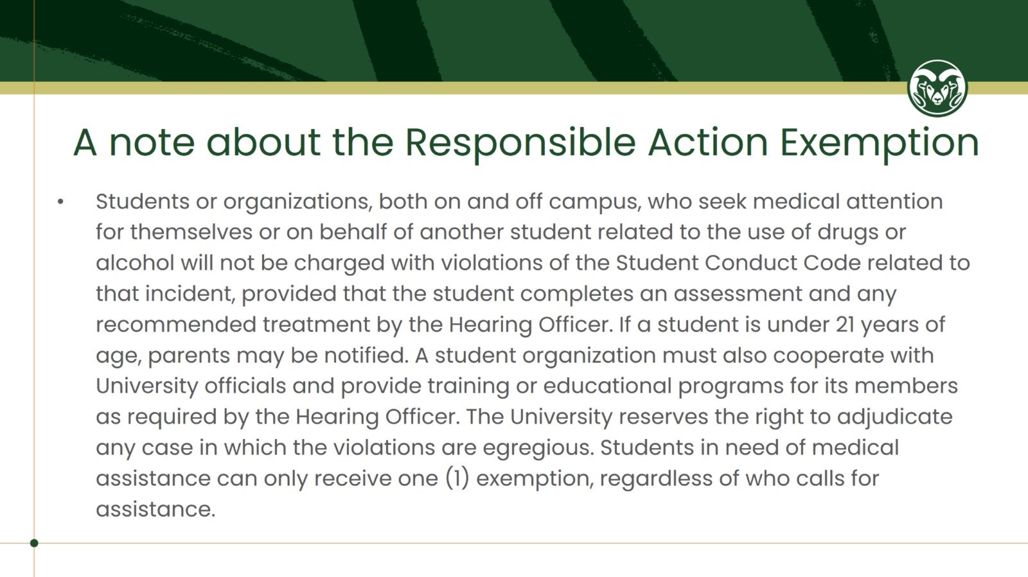
A note about the Responsible Action Exemption

Slide 20

Hazing

Slide 21
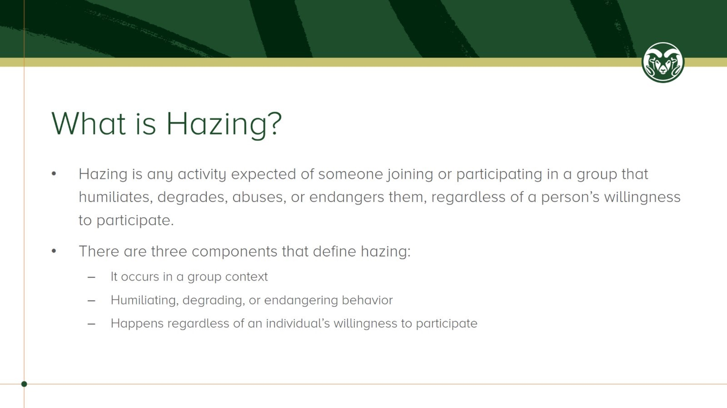
What is Hazing?

Slide 22
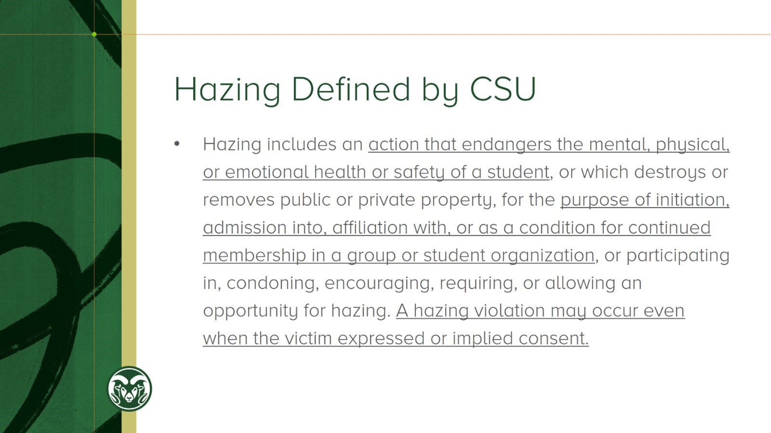
Hazing Defined by CSU

Slide 23

Scan this QR Code to complete this post presentation comprehension assessment.

